Slide 1

Public
Employee
Claims
Division
Workers’ Compensation
Initial Procedures

Slide 2

INJURY HOTLINE
1-855-339-1893
Available 24 hours / 7 days a week
Registered Nurses
  Nationwide Coverage
  Translation Services
    Medical referral to designated clinic or ER
    Document the “Report of Injury”

Slide 3
The Benefits of Making the “Right Call”
for Workplace Injuries
The Right Time - Employers respond to workplace
injuries on the “Day of Injury”
The Right Care - Medical expertise at the time of injury
results in the most appropriate and cost-
effective level of care.
The Right Results - Reduction in lost time, overall claims
        cost, legible claims

Slide 4


If it is an EMERGENCY, seek
treatment first!
Call Company Nurse after treatment to report the injury.
A call to the Company Nurse Hotline MUST be made to report the injury.

Slide 5

Simple Steps to Follow…
The injured employee should notify his/her supervisor immediately.
If NO medical treatment is needed, complete only the Incident Report and retain in the employee’s file. Do not call Company Nurse and do not send the report to the Public Employee Claims Division.
Call the Company Nurse Injury Hotline WHEN medical treatment is needed.

Slide 6

Simple Steps to follow…
Injured employee should call the Company Nurse Injury Hotline. If the injured employee cannot make the call, the supervisor should call.
Company Nurse will gather all the appropriate information and make care recommendations.
Company Nurse will fax the incident report to the designated treatment facility prior to the injured employee’s visit.

Slide 7


Claim Forms
The phone call to The Company Nurse Injury Hotline will generate the workers’ compensation claim forms.
Company Nurse will email the workers’ compensation forms to the appropriate agency’s contact person and to the Public Employee Claims Division within five minutes of a phone call being made to Company Nurse.

Slide 8

Simple Steps to follow…
The agency’s contact will need to print the forms.
The supervisor and injured employee will need to review the forms, complete any blank forms and make appropriate changes. All the forms will need to be signed and sent to the Public Employee Claims Division in a timely manner.

Slide 9

Forms attached in email:
* Company Nurse Report of Injury
* Workers’ Compensation – First Report of Injury or Illness Form
* Form N – Employee’s Notice of Injury
* Form N Acknowledgement Form
* Form PECD 1 – Employee’s Report of Accident
* Form PECD 2 – Employer’s Report of Accident

Slide 10
Claim Forms…
The completed forms need
to be faxed to
Public Employee Claims Division
501-371-2733

Slide 11
Example Forms

Slide 12
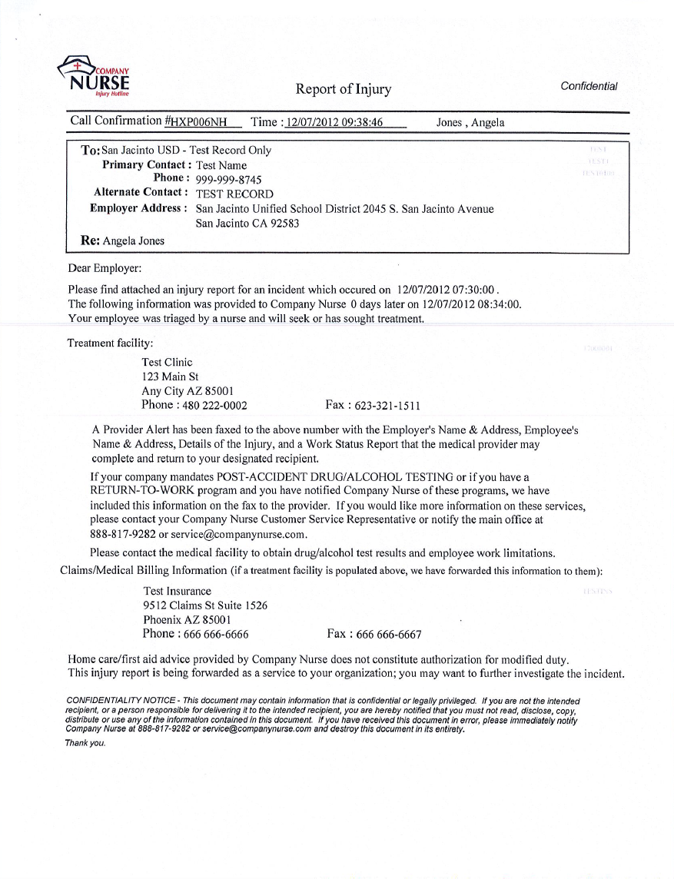
Sample –
pg. 1 of 3
Sent to Designated Treatment facility

Slide 13
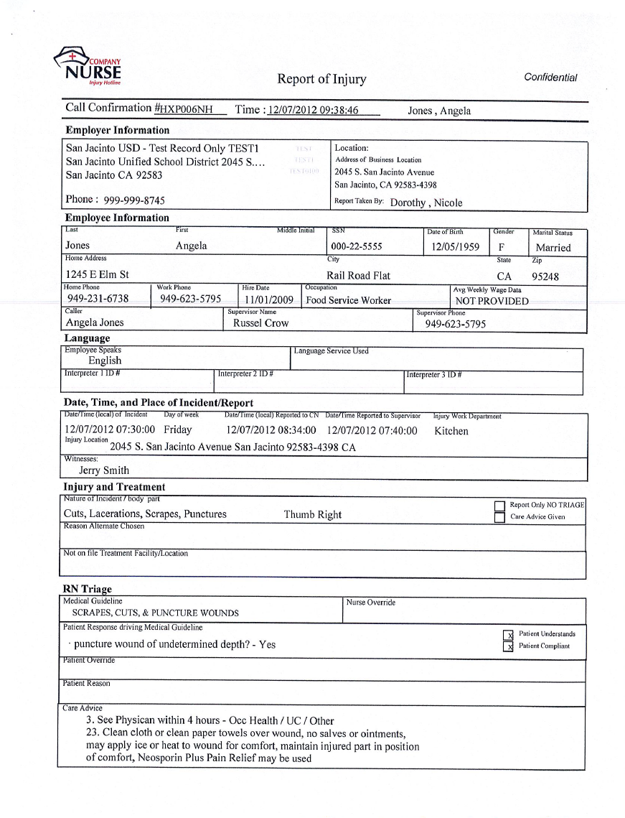
pg. 2 of 3

Slide 14
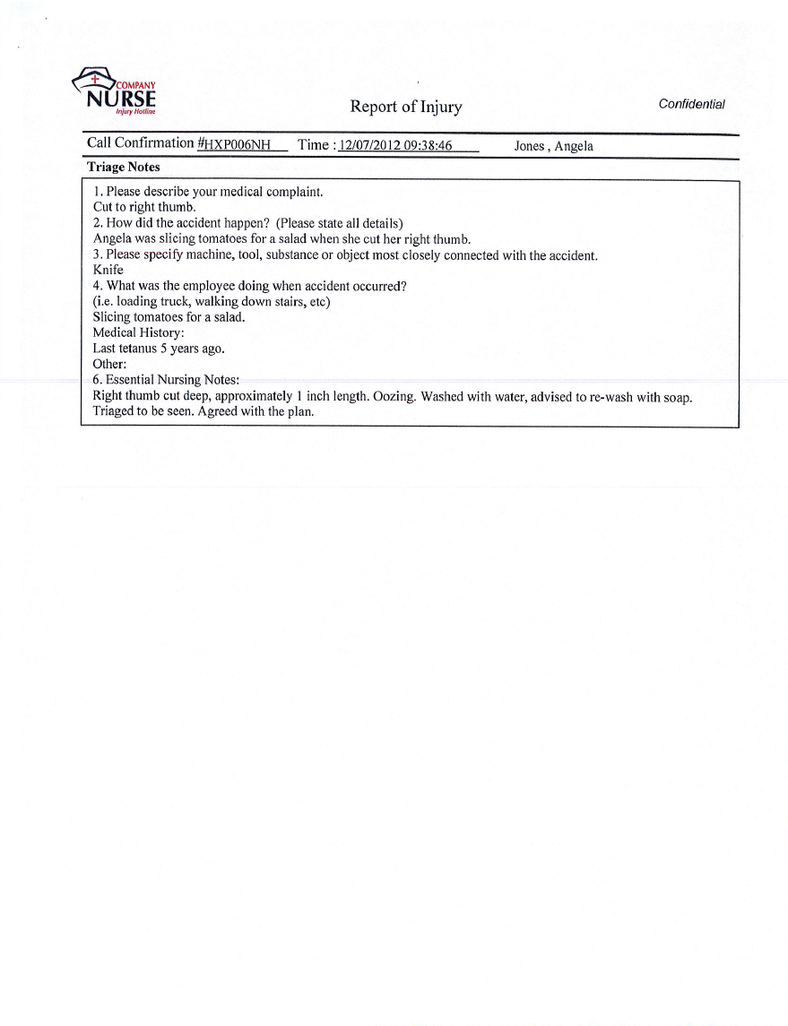
pg. 3 of 3

Slide 15
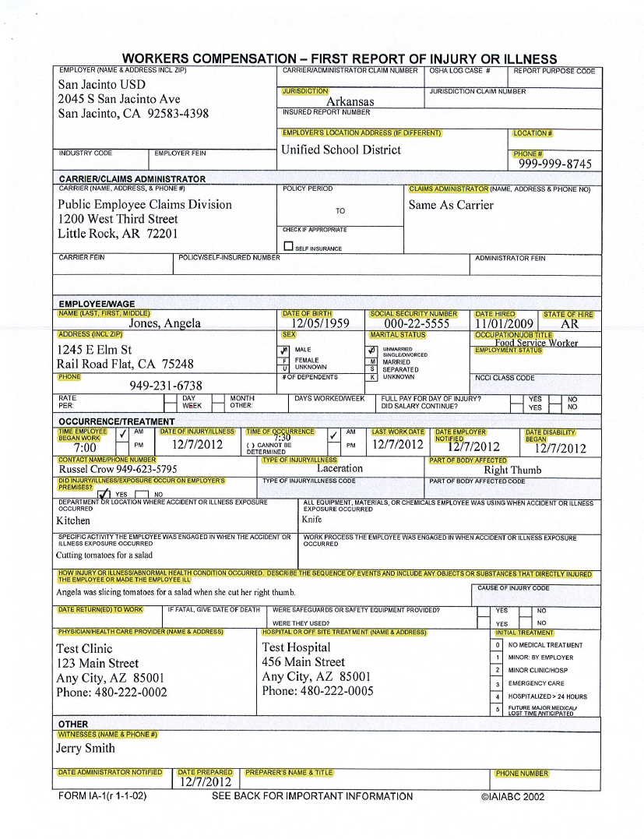
Sample Claim
pg. 1 of 6
Sent to Public Employee Claims Division and personnel specified by agency
Preparer’s signature is WC Claims Specialist or WC Analyst in Public Employee Claims Division

Slide 16
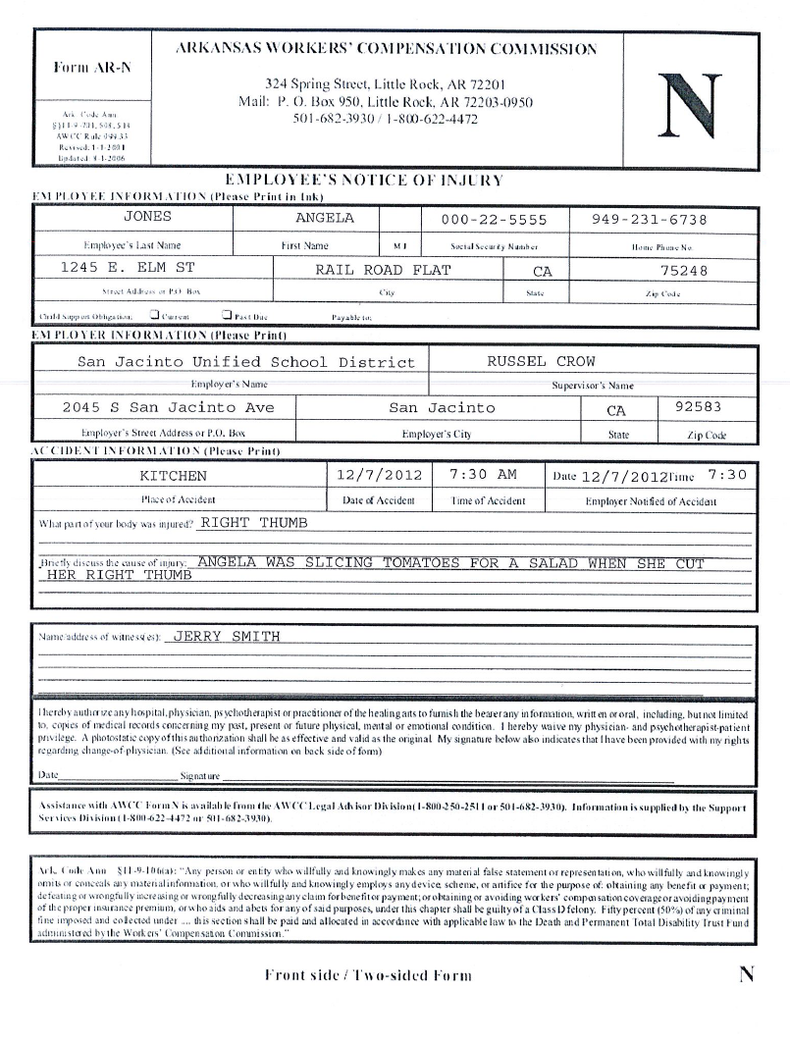
pg. 2 of 6
(two-sided)
Employee signature required on front and back side.
Make sure employee is given a copy of the front and back side of this form.

Slide 17
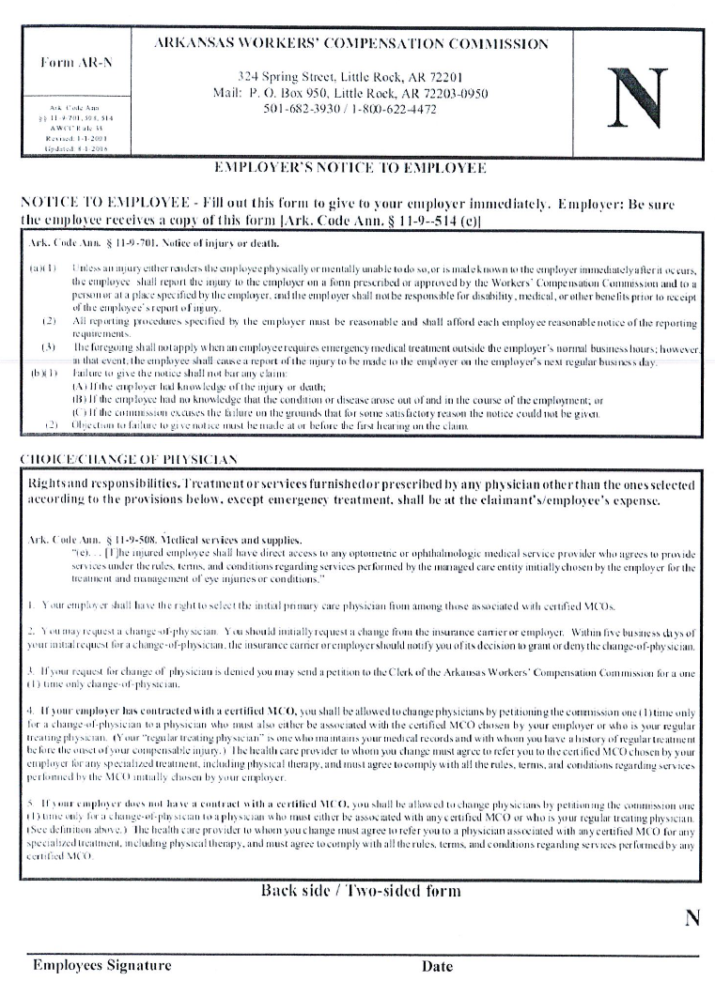
pg. 3 of 6
(back side)
Employee signature required on front and back side.
Make sure the employee is given a copy of the front and back side of this form.

Slide 18
Form N Acknowledgement
pg. 4 of 6
Have the injured employee complete, sign and date this form to acknowledge receipt of the front and back of the Form N. Fax this with the completed initial claims forms.

Slide 19
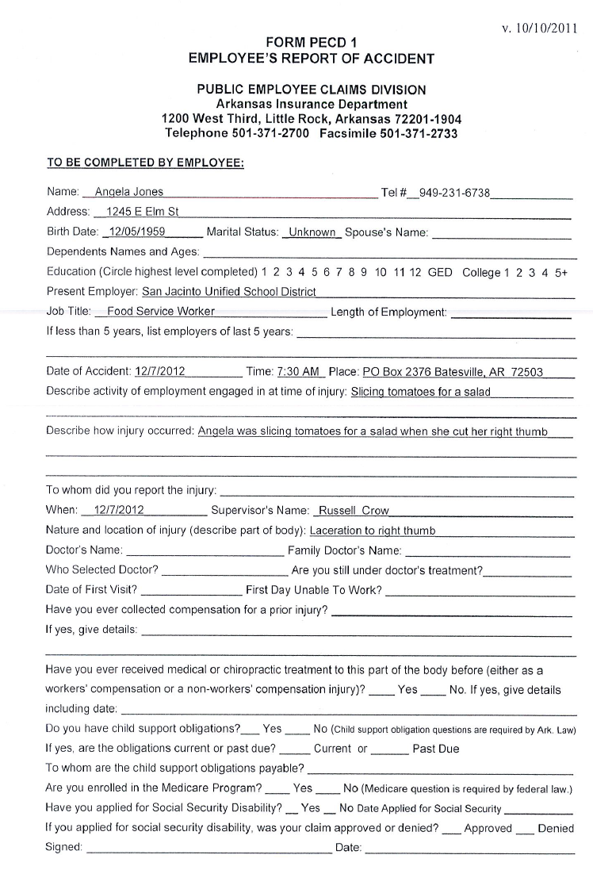
pg. 5 of 6
Employee signature required

Slide 20
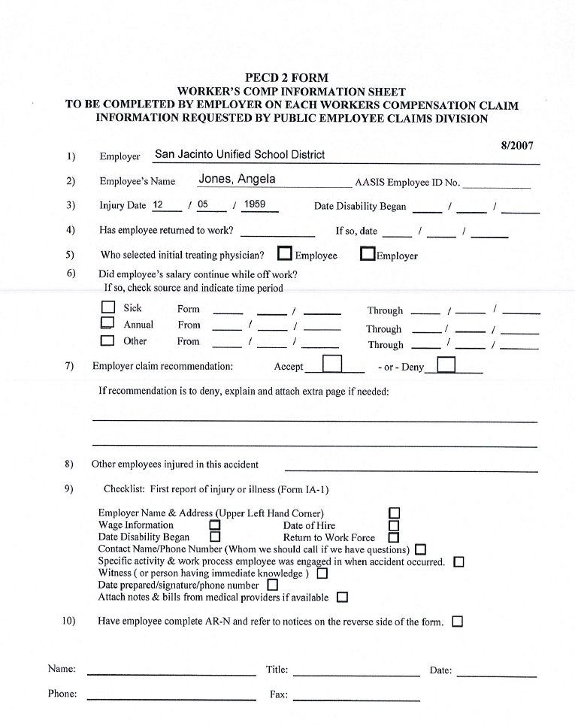
pg. 6 of 6
Supervisor signature required

Slide 21
Forms to Be Posted
Form P – Workers’ Compensation Notice
Form H – Managed Care Notice
Company Nurse Form

Slide 22
Forms to Be
Posted –
Form P

Slide 23
Forms to Be Posted -
Form H

Slide 24
Forms to Be Posted –
Company Nurse Form

Slide 25
Incident Report Form to use if an agency does not have one for incidents not requiring medical treatment

Slide 26
What is a Call
Confirmation Number?
* A number (eight-digit alphanumeric) assigned to the Report of Injury to reference the call.
* In some cases a follow-up call MAY be necessary and this number references the original call.
* The injured employee should record and
maintain this number.

Slide 27

Temporary Prescription Form
* Supervisor/Designated Person needs to complete the form and give to the injured employee at the time he/she reports the injury.
The form needs to be given to the employee prior to receiving medical treatment, if possible.

Slide 28
Temporary
Prescription
Form

Slide 29


Frequently Asked Questions
(FAQ)
Q. Should every workplace injury be reported to The Company Nurse Hotline?
A. No, only when medical treatment is needed.
Q. My date of injury was before the implementation date. Do I call the Company Nurse Hotline or complete forms?
A. If the injury has not been previously reported, call Company Nurse. If the injury has been reported, complete the remainder of the forms and fax to Public Employee Claims Division.

Slide 30
Q. Will The Company Nurse Hotline provide general health care advice?
A. No. This hotline is only for work-related injuries that need medical treatment.
Q. Is the call confirmation number the same as the claim number?
A. No
Q. Is The Company Nurse Hotline my Workers’ Compensation Insurance?
A. No. Company Nurse provides the initial injury triage, offers care advice and initiates the injury reporting process. Public Employee Claims Division (PECD) is responsible for our claims processing and administration.

Slide 31
Q. What happens if the employee is on HOLD for an extended period of time waiting for a Nurse?
A. The protocol is to answer every call – there is no voicemail. Calls are initially answered by an Injury Care Coordinator (ICC). During unexpected high volume time periods, the ICC will take a contact phone number, and a Nurse will return a call as soon as possible, typically within a few minutes. Average length of call is 8 – 12 minutes.
Q. After the injured employee has been treated by a medical provider, does he/she need to call The Company Nurse Hotline back and update them with the treatment outcome and/or progress?
A. No. Any updates on the employee’s condition, after treatment should be provided to their supervisor and Public Employee Claims Division.

Slide 32
Summary of Procedures
The injured employee should notify his/her supervisor immediately. In the case of an emergency, call 911 or transport the injured employee to the closest Emergency Room (ER) facility.
The injured employee should call the Company Nurse Injury Hotline. If the injured employee cannot make the call, the supervisor should call.
Company Nurse will gather all the appropriate information and make care recommendations.

Slide 33
Summary of Procedures…
Company Nurse will email a Report of Injury to the appropriate contact person(s) designated by the agency, and the Public Employee Claims Division. The Report of Injury is for information only. There is nothing to be done with this report.
Company Nurse will email the workers’ compensation forms (pre-generated with the information called into Company Nurse) to the designated agency contact person and the Public Employee Claims Division.

Slide 34
Summary of Procedures…
The contact person designated by the agency will need to print the forms. The supervisor and injured employee will need to review the following forms and make appropriate changes: AR-N, PECD Form 1, All the forms will need to be signed and faxed to Public Employee Claims Division at 501-371-2733.
The supervisor or other employee designated by the agency will need to give the injured employee the Temporary Prescription Form prior to the employee receiving medical treatment (if possible).

Slide 35
Public Employee Claims Division
1200 W. Third Street
Little Rock, AR 72201
501-371-2700 - Main Number
Fax Numbers
501-371-2733 New Claims Only
501-371-2724 Correspondence

